Slide 1
Chapter 2
Database System Concepts and Architecture

Slide 2
Data Models
Data Model: A set of concepts to describe the structure of a database, and certain constraints that the database should obey.
Data Model Operations: Operations for specifying database retrievals and updates by referring to the concepts of the data model. Operations on the data model may include basic operations and user-defined operations.

Slide 3
Categories of data models
Conceptual (high-level, semantic) data models: Provide concepts that are close to the way many users perceive data. (Also called entity-based or object-based data models.)
Physical (low-level, internal) data models: Provide concepts that describe details of how data is stored in the computer.
Implementation (representational) data models: Provide concepts that fall between the above two, balancing user views with some computer storage details.

Slide 4
Schemas versus Instances
Database Schema: The description of a database. Includes descriptions of the database structure and the constraints that should hold on the database.
Schema Diagram: A diagrammatic display of (some aspects of) a database schema.
Schema Construct: A component of the schema or an object within the schema, e.g., STUDENT, COURSE.
Database Instance: The actual data stored in a database at a particular moment in time. Also called database state (or occurrence).

Slide 5
DBMS Languages
Data Definition Language (DDL): Used by the DBA and database designers to specify the conceptual schema of a database. In many DBMSs, the DDL is also used to define internal and external schemas (views). In some DBMSs, separate storage definition language (SDL) and view definition language (VDL) are used to define internal and external schemas.

Slide 6
DBMS Languages
Data Manipulation Language (DML): Used to specify database retrievals and updates.
  DML commands (data sublanguage) can be embedded in a general-purpose programming language (host language), such as COBOL, C or an Assembly Language.
  Alternatively, stand-alone DML commands can be applied directly (query language).

Slide 7
DBMS DML Languages
High Level or Non-procedural Languages: e.g., SQL, are set-oriented and specify what data to retrieve than how to retrieve. Also called declarative languages.
Low Level or Procedural Languages: record-at-a-time; they specify how to retrieve data and include constructs such as looping.

Slide 8
DBMS Interfaces
  Menu-based, popular for browsing on the web
  Forms-based, designed for naïve users
  Graphics-based (Point and Click, Drag and Drop etc.)
  Natural language: requests in written English
  Interfaces for the DBA:
    Creating accounts, granting authorizations
    Setting system parameters
    Changing schemas or access path

Slide 9
Database System Environment
DBMS Component Modules
  instead of a single integrated system
  stored database manager: disk control
  DDL compiler: processes schema definitions and stores in the DBMS catalog
  run-time database processor: receives & executes operations (in an object code)
  query compiler, pre-compiler, DML compiler

Slide 10
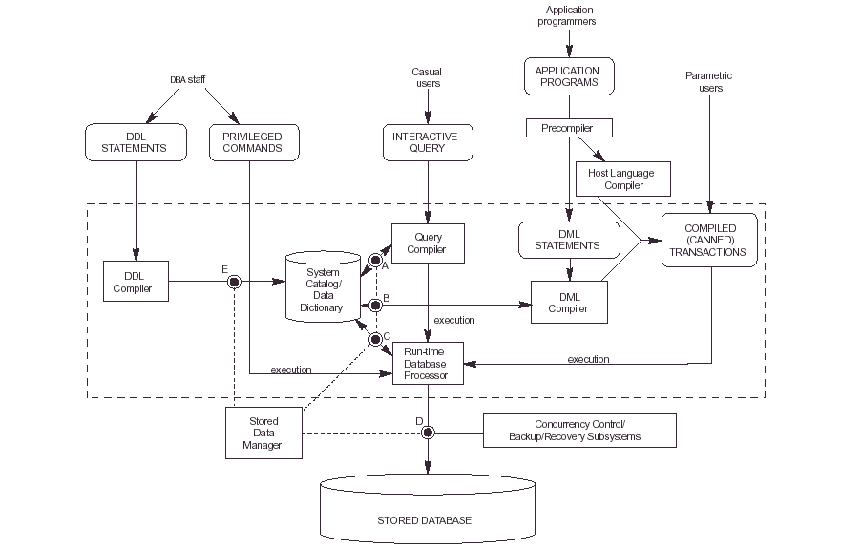

Slide 11
Database System Utilities
To perform certain functions such as:
  Loading data stored in files into a database. Includes data conversion tools.
  Backing up the database periodically on tape.
  Reorganizing database file structures.
  Report generation utilities.
  Performance monitoring utilities.
  Other functions, such as sorting, user monitoring, data compression, etc.

Slide 12
Other Tools
Data dictionary / repository:
    Used to store schema descriptions and other information such as design decisions, application program descriptions, user information, usage standards, etc.
    Active data dictionary is accessed by DBMS software and users/DBA.
    Passive data dictionary is accessed by users/DBA only.
Application Development Environments and CASE (computer-aided software engineering) tools:
    Examples – Power builder (Sybase), Builder (Borland)

Slide 13
Centralized and Client-Server Architectures
Centralized DBMS: combines everything into single system including- DBMS software, hardware, application programs and user interface processing software.

Slide 14
Basic Client-Server Architectures
Specialized Servers with Specialized functions
Clients
DBMS Server

Slide 15
Specialized Servers with Specialized functions:
File Servers
Printer Servers
Web Servers
E-mail Servers

Slide 16
Clients
Provide appropriate interfaces and a client-version of the system to access and utilize the server resources.
Clients maybe diskless machines or PCs or Workstations with disks with only the client software installed.
Connected to the servers via some form of a network.
(LAN: local area network, wireless network, etc.)

Slide 17
DBMS Server
Provides database query and transaction services to the clients
Sometimes called query and transaction servers

Slide 18
Two Tier Client-Server Architecture
User Interface Programs and Application Programs run on the client side
Interface called ODBC (Open Database Connectivity ) provides an Application program interface (API) allow client side programs to call the DBMS. Most DBMS vendors provide ODBC drivers.

Slide 19
Two Tier Client-Server Architecture
A client program may connect to several DBMSs.
Other variations of clients are possible: e.g., in some DBMSs, more functionality is transferred to clients including data dictionary functions, optimization and recovery across multiple servers, etc. In such situations the server may be called the Data Server.

Slide 20
Three Tier Client-Server Architecture
Common for Web applications
Intermediate Layer called Application Server or Web Server:
  stores the web connectivity software and the rules and business logic (constraints) part of the application used to access the right amount of data from the database server
  acts like a conduit for sending partially processed data between the database server and the client.
Additional Features- Security:
  encrypt the data at the server before transmission
  decrypt data at the client

Slide 21
Classification of DBMSs
Based on the data model used:
  Traditional: Relational, Network, Hierarchical.
  Emerging: Object-oriented, Object-relational.
Other classifications:
  Single-user (typically used with micro- computers) vs. multi-user (most DBMSs).
  Centralized (uses a single computer with one database) vs. distributed (uses multiple computers, multiple databases)

Slide 22
Classification of DBMSs
Distributed Database Systems have now come to be known as client server based database systems because they do not support a totally distributed environment, but rather a set of database servers supporting a set of clients.

Slide 23
Variations of Distributed Environments:
Homogeneous DDBMS
Heterogeneous DDBMS
Federated or Multimediadatabase Systems

